Slide 1











Slide 2





Arithmetic | Uni |  | ++ |  |  |  |  |  |  | --
 | Bi |  | + |  |  | - |  |  | * |  |  |  | / |  | %
Bit wise | & | | |  | ~ |  |  |  | ^ |  |  | >> |  |  | <<
Assignment | = | += | -= |  |  | *= |  |  | /= |  |  |  | %= |  | +=
 | &= | |= |  | ^= |  |  |  | >>= |  |  | <<=
Relational | > | < |  | >= |  |  |  | <= |  |  | == |  |  | !=
Logical | && |  |  |  | || |  |  |  |  |  |  | !
Other | Size of operator |  |  |  |  |  | sizeof()
 | Ternary operator |  |  |  |  |  | ? : ;
 | Address operator |  |  |  |  |  | & ( will be discussed later )
 | Dereference |  |  |  |  |  | * ( will be discussed later )
 | Subscriptor |  |  |  |  |  | [ ] ( will be discussed later )

Slide 3








True
False
Any number not equals to zero
0
1 is true
1000 is true
-4 is true
Any number except 0 is true
Note, if there is a statement in c that returns true, the compiler is free to choose the
value of the true with the rule that it must be any number except 0.

Slide 4





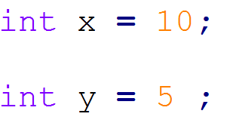
This operators are used to check the relation between new values and return either true or false.
Check Equality
example
Check Not Equality
example
Check More Than
example
Check More Than or equal
example

Slide 5
This operators are used to check the relation between new values and return either true or false.
Check Less Than
example
Check Less Than or equal
example
Note, if you tried to print false value, the value that will be printed is 0
Note, if you tried to print true value, the value that will be printed is not zero and chosen by the compiler, in most cases it will be 1 or 255

Slide 6





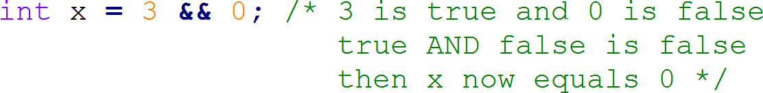
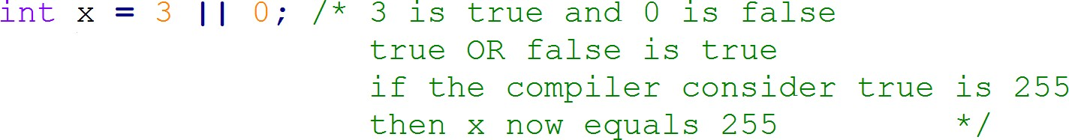
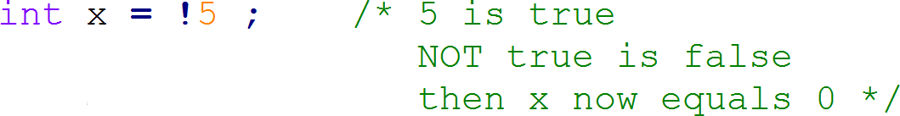
These operators are used to apply logical operation between two values, each value will be considered either false if it is 0 or true if it is not 0.
1- Logical And
example
2- Logical OR
example
3- Logical Not
example

Slide 7








Expected Output
Write a C code to print the false value and the true value on GCC.

Slide 8




Conditional statements are used to execute some code under certain conditions.
C defines 2 different conditional statements. 1- if Statement
2- switch Statement

Slide 9







Syntax
Case_1 : Only if condition
if condition_1 is true
if ( condition_1 )
{
Action_1
}
Yes
Execute Action_1

Slide 10




Expected Output
Write a C code to calculate employee salary in a week based on the his working hours, hour rate is 50.
The program will ask the user to enter the working hours, then it will print his salary.
But if the working hours are less than 40
hours, a 10% deduction will be applied.

Slide 11


Syntax
Case_2 : if, else if statement
if condition_1 is true
if ( condition_1 )
{
Action_1
}
Yes
No
Execute Action_1
else if condition_2 is true
else if ( condition_2 )
{
Action_2
}
Yes
Execute Action_2

Slide 12
Syntax
Case_3 : if, else statement
if ( condition )
{
Action_1
}
if condition_1 is true
Yes
No
Execute Action_1
Execute Action_2
else
{
Action_2
}

Slide 13



Expected Output
Write a C code that ask the user to enter a number and check if it is Even or Odd number

Slide 14

Syntax
Case_4 : if, else if , else condition
if ( condition_1 )
{
Action_1
}
if condition_1 is true
Yes
No
else if ( condition_2)
{
Action_2
}
Execute Action_1
else if condition_2 is true
No
Yes
else
{
Action_3
}
Execute Action_3
Execute Action_2

Slide 15






Expected Output
Write a C code to ask the user to enter his grade and the program will print his rating.
0 <= grade < 50
50 <= grade < 65
65 <= grade < 75
75 <= grade < 85
85 <= grade
------> Failed
------> Normal
------> Good
------> Very Good
------> Excellent

Slide 16
General Rules:
else if statement is optional, you may have no else if, you may have one, you may have more, no limit.
else statement is optional, you can have only one else statement. 3- No code is allowed to be written between if and else if or else.
Nested if is allowed.
if the condition in if statement is a combination between many conditions, use round brackets ( ) with each condition to avoid precedence issues.
In case of only one action only should be taken in if statement, you may not use
{ }, but it is always preferred to use { } even if only one action is required.

Slide 17


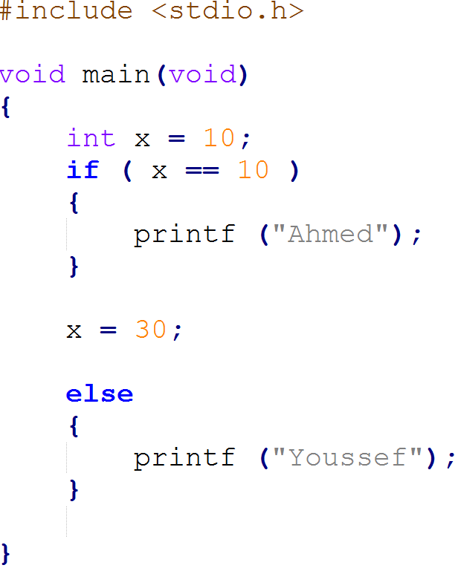
What will be the output of the following code … ?
Ahmed
Youssef
compilation error
30

Slide 18

What will be the output of the following code … ?
Ahmed
Youssef
compilation error
30
Reason:
No code is allowed between if and else

Slide 19



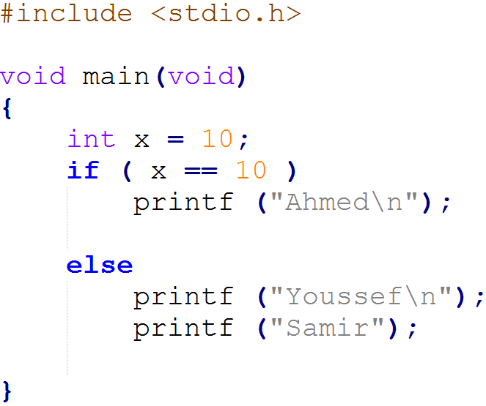
What will be the output of the following code … ?
Ahmed
Youssef
compilation error
Ahmed Samir

Slide 20

What will be the output of the following code … ?
Ahmed
Youssef
compilation error
Ahmed Samir
Reason:
No { } with else statement, then only one statement is corresponding to else.

Slide 21




























Switch statement is a control statement that
Switch On a variable
allows us to choose only one choice among many choices.
It compares the a variable value with the values present in the different cases. Then it executes that block of code which matches the case value.
Variable = constant_1 ?
break ?
case constant_1:
Action_1
Variable = constant_2 ?
case constant_2:
Action_2
break ?
Variable = constant_3 ?
case constant_3:
Action_3
break ?
Other value
default:
Action_4
If there is no match, then default block is executed
End

Slide 22





Expected Output
Login System:
Write a C code that ask the user to enter his ID and
then the program will print his name.
Available IDs are:
1234-> Ahmed
5678 -> Youssef
1145 -> Mina
Any other number, the program will print Wrong ID

Slide 23



1.case constant must be unique 2.case constant can’t be a variable 3.case constant must be integral value 4.Only one default is allowed
default label is Optional
default can be placed anywhere in the switch
break Statement ends the switch
if the break statement is not exist, the all following code will be executed until the end of the switch or until it finds a break statement without checking the case constant
Nesting ( switch within switch ) is allowed.

Slide 24
Any questions
… ?

Slide 25

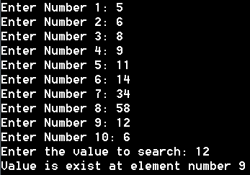

Expected Output
Write a C code that ask the user to enter 10 numbers, then ask him to enter another number to search on it in the 10 numbers and print its location in case it is found.
In case the number is not found, it will print number no exist

Slide 26


Write a C code that ask the user to enter his ID, if the ID is valid it will ask the user to enter his password, if the password is correct the program will print the user name, if the password is incorrect the program will print Incorrect Password.
In case of not existing ID, the program will print Incorrect ID

Slide 27


Expected Output
Write a code that will ask the user to enter 3 numbers, the program will print the maximum number of them.

Slide 28
Thank you

